Slide 1
Gandhinagar Institute of Technology
EEE (2110005) - ACTIVE LEARNING ASSIGNMENT
ELECTROMAGNETIC INDUCTION
PREPARED BY:- RIYA SIMON MATHEW
ENROLLMENT NO:- 130120111024
BRANCH:- EC

Slide 2
CONTENTS
INTODUCTION
FARADAY’S EXPERIMENT AND LAWS
DIRECTION OF INDUCED E.M.F
NATURE OF INDUCED E.M.F

Slide 3
ELECTROMAGNETIC INDUCTION
Phenomenon by which an emf (voltage) is produced in a wire (conductor) by a changing magnetic flux.
Magnetic flux is a product of magnetic field and the area through which magnetic field passes.
Ø=BA

Slide 4
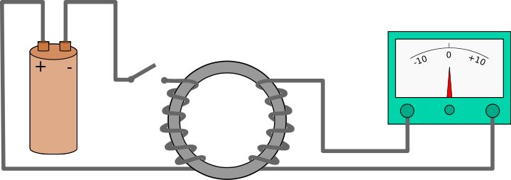
FARADAY EXPERIMENT
Almost 200 years ago, Faraday looked for an evidence that a magnetic field would induce an electric current with this apparatus
galvanometer
switch
iron
X
Y
battery

Slide 5
Faraday’s 1st Law
Whenever the magnetic lines of forces (flux) linking with the coil or conductor changes, an emf get induced in the coil or conductor. Such an emf lasts as long as some change is taking place.

Slide 6
Induced EMF
He found no evidence when the current was steady,but did see a current induced when the circuit was switched on or off.

Slide 7
Faraday’s 2nd Law
The magnitude of an induced emf is directly proportional to the rate of change of flux linkage. Where,
induced emf= no. of turns of coil* change in flux
e= N dØ N= no of turns of coil
dt e= induced emf
dØ = change in flux
dt
* Note that the emf is only produced when flux changes.

Slide 8
DIRECTION OF INDUCED EMF( Or Current)
Fleming’s Right hand Rule
Lenz’s Law

Slide 9
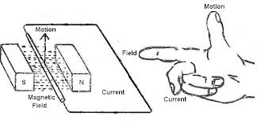
Fleming’s Right Hand Rule
Thumb:- direction of conductor motion
1st finger:-direction of flux
2nd finger:-direction of induced emf/ current

Slide 10
Lenz’s Law
There is an induced current in the closed conducting loop if and only if the magnetic flux through the loop is changing.
The direction of the current is such that the induced magnetic field always opposes the change in the flux.

Slide 11
NATURE OF INDUCED EMF
Dynamically induced emf
Statically induced emf

Slide 12
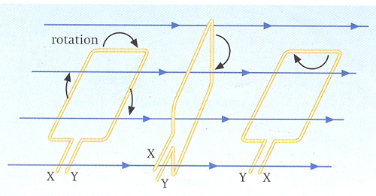
Dynamically induced emf
By moving the conductor keeping the magnetic field system stationary, so that the flux is cut by the conductor, the e.m.f thus is induced in the conductor is called dynamically induced e.m.f.

Slide 13
Statically induced emf
It if further classified into two:-
Self induced e.m.f
Mutually induced e.m.f

Slide 14
Self Induced e.m.f
Self-induced emf is the e.m.f induced in a circuit when the magnetic flux linking it changes the flux being produced in the same circuit.
The direction of the induced e.m.f is such that it opposes the cause which produces it (lenz’s law) i.e. change of current in the coil.
So, the magnitude of self-induced e.m.f is directly proportional to the rate of change of current in the coil.

Slide 15
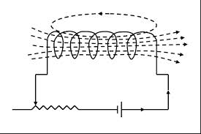
e α di
dt
e=L di
dt
Where, L is proportionality constant and is called coefficient of self induced e.m.f.
The process by which an electromotive force(e.m.f) is induced by varying current in that circuit is called self induction.

Slide 16
COEFFICIENT OF SELF INDUCTION:-
Consider a coil of N turns carrying a current i which produces flux linking with the coil. Acc. To faraday’s law, the e.m.f induced in a coil is given by,
e= -N dØ di
di dt
For a coil of non-magnetic core, the flux is directly proportional to the current. Hence,
dØ = Ø = constant
di i
,

Slide 17
hence., tne eqn. becomes
e= -N Ø di
I dt
= - L di
dt
Where, L =N Ø = self inductance of the coil
i

Slide 18
MUTUAL INDUCTION
Mutual inductance may be defined as the ability of one coil to produce an e.m.f in a second coil by induction when the current in the first coil is changes. This action is reciprocal.
This ability of reciprocal induction is measured in terms of mutual inductance or coefficient of mutual induction. It is denoted by M.
e α di
dt
e = M di
dt

Slide 19
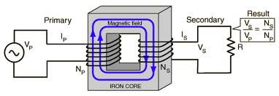
COEFFICIENT OF MUTUAL INDUCTANCE:-
Coefficient of mutual inductance between two circuits is defined as the e.m.f induced in one circuit when the current in the other circuit changes as the rate of 1 A/sec.
so, if di = 1A/sec
dt
then, M = e
di/dt
M=e

